Slide 1
TRANSNORTHERN
METROLINER 16,000 lbs DIFFERENCES TRAINING

Slide 2
References:
Far 135.347
Ac_120-53b
TNA training manual 1.7.5.2:
“TransNorthern Aviation has evaluated its aircraft and identified Level A differences only. These differences will be instructed in module 4.5.3.3, Differences Training and recorded on form 5.14, Special Subjects.”

Slide 3
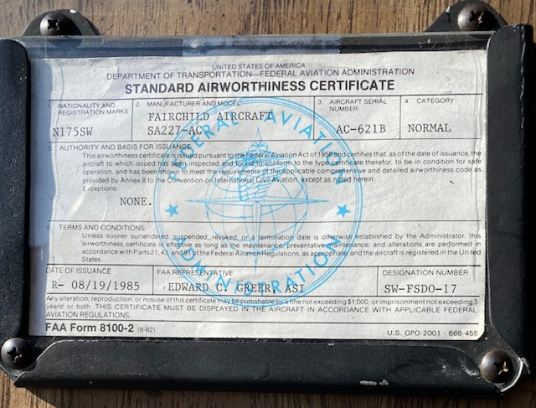
16,000 lbs metro:
N75TN (N175SW)
SERIAL NUMBER: AC-621B
CERTIFIED UNDER SFAR 41
NORMAL CATEGORY
LARGE NON-TRANSPORT
Notes:
Insert pic of airworthiness certificate.

Slide 4
Limitations
14,500 lbs Metro (KIAS)
16,000 lbs Metro (KIAS)
Vmo: 246 / Mmo: 0.52
Va: 176
Vlo: 176
Vle: 173
Vfe (1/4): 214
Vfe (1/2): 179
Vfe (full): 159
Vmca: 87
Vsse: 115
Vmo: 246 / Mmo: 0.52
Va: 185
Vlo: 175
Vle: 175
Vfe (1/4): 215
Vfe (1/2): 185
Vfe (full): 160
Vmca: 91
Vsse: 115

Slide 5
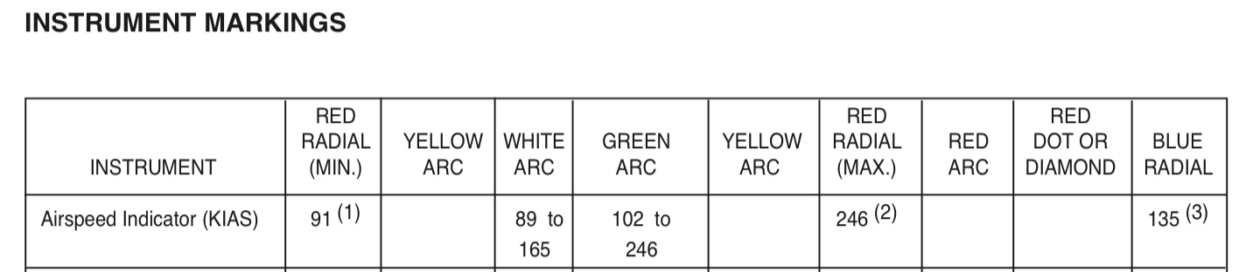
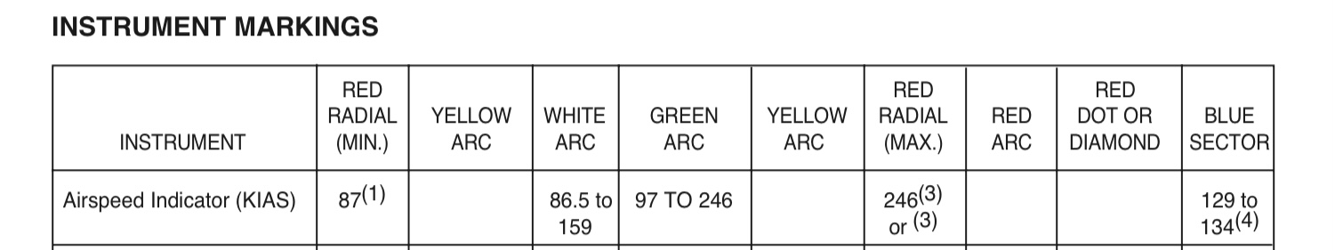
Limitations
16,000 lbs Metro:
14,500 lbs Metro:

Slide 6
Limitations
14,500 lbs Metro
16,000 lbs Metro
MRW: 14,600 lbs
MGTW: 14,500 lbs
MLW: 14,000 lbs
MZFW: 13,130 lbs
MAX FWD BAGGAGE COMP: 800 lbs
MAX AFT BAGGAGE COMP: 850 lbs
MAX FLOOR LOADING: 150 LBS / ft2
MRW: 16,100 lbs
MGTW: 16,000 lbs
MLW: 15,500 lbs
MZFW: 13,900 lbs
MAX FWD BAGGAGE COMP: 800 lbs
MAX AFT BAGGAGE COMP: 850 lbs
MAX FLOOR LOADING: 150 LBS / ft2

Slide 7
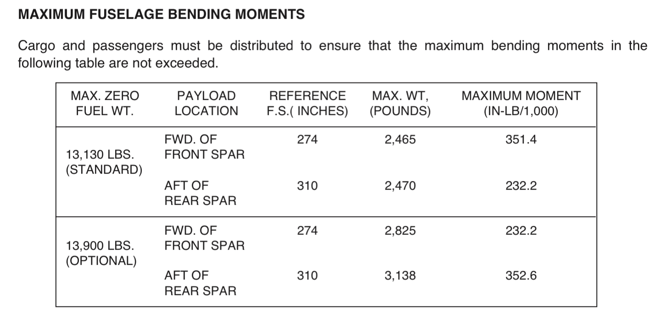
Fuselage Bending moments

Slide 8
Limitations
Maximum fuel imbalance for takeoff and landing is:
200 pounds when total fuel is greater than 2,000 pounds.
400 pounds when total fuel is less than 2,000 pounds.

Slide 9
Misc. differences
RMI VOR NEEDLE #1 IS NOT CONNECTED.
RMI VOR NEEDLE #2 IS CONNECTED TO #2 VOR (SIC).
ONE ADF INSTALLED ON LOWER CENTER COLUMN.
ENGINE FIRE WARNING LIGHTS INSTALLED ABOVE DASHBOARD.

Slide 10
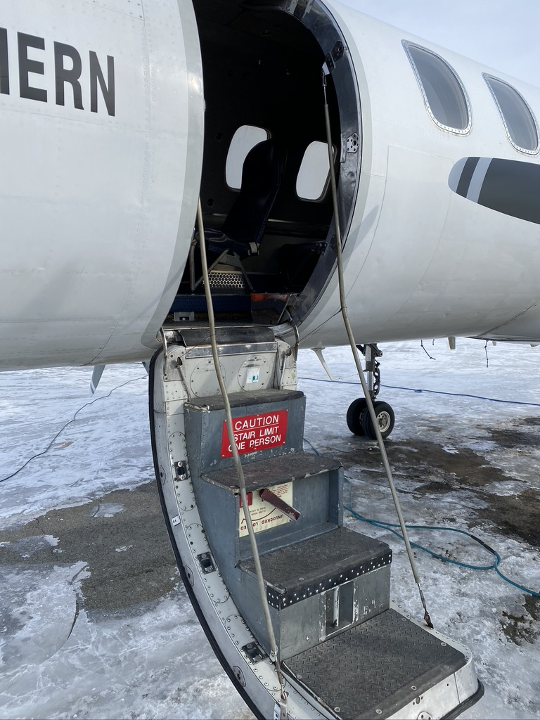
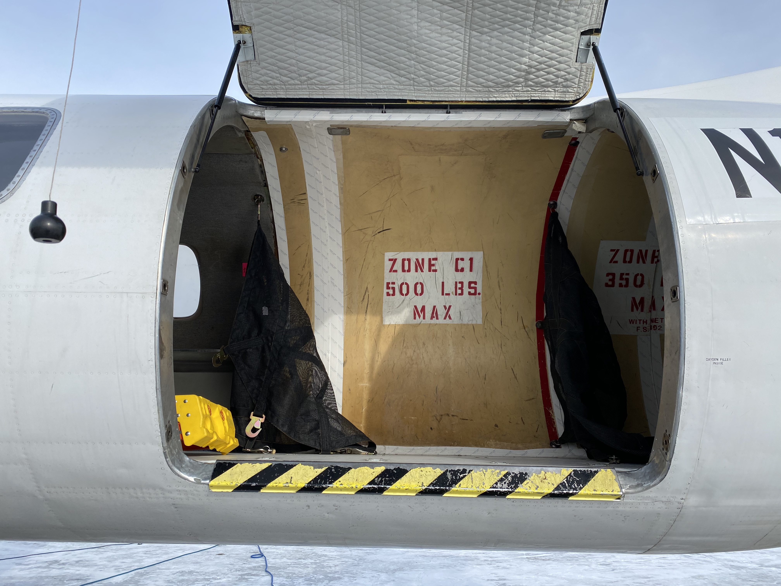
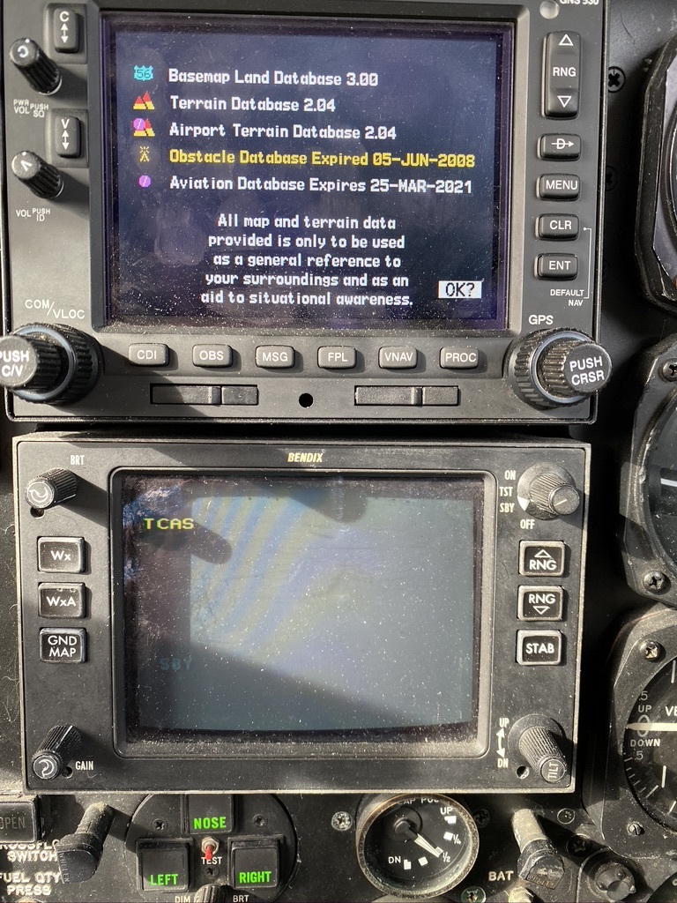
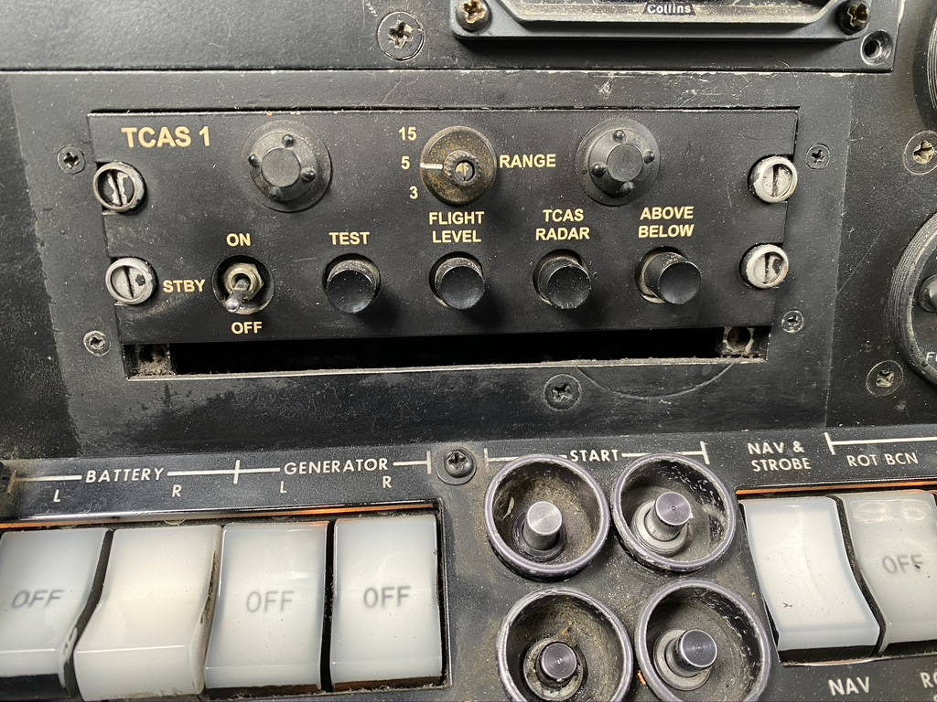
MISC. DIFFerences

Slide 11
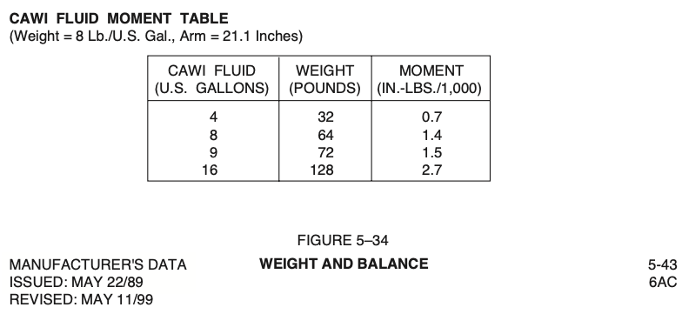
Cawi limitations
14,500 Metro: 8 gallons minimum quantity
16,000 Metro: 9 gallons minimum quantity
For weight & balance, CAWI must be considered:

Slide 12
CAWI performance
At what temperature do we have to start reducing takeoff weight?
ANC, FAI, long runways
Sea Level
16,000 lbs
Dry, Bleed Air OFF (Figure 4D-2)
ANSWER: +23 C
ANC, FAI long runways
Sea Level
16,000 lbs
Wet (Figure 4E-2)
ANSWER: +37 C

Slide 13
CAWI performance
At what temperature do we have to start reducing takeoff weight?
DUT 4,500’ runway
Sea Level
Calm wind
16,000 lbs
Dry, Bleed Air OFF (Figure 4D-11)
ANSWER: +12 C
DUT 4,500’ runway
Sea Level
Calm wind
16,000 lbs
Wet (Figure 4E-11)
ANSWER: +25 C

Slide 14
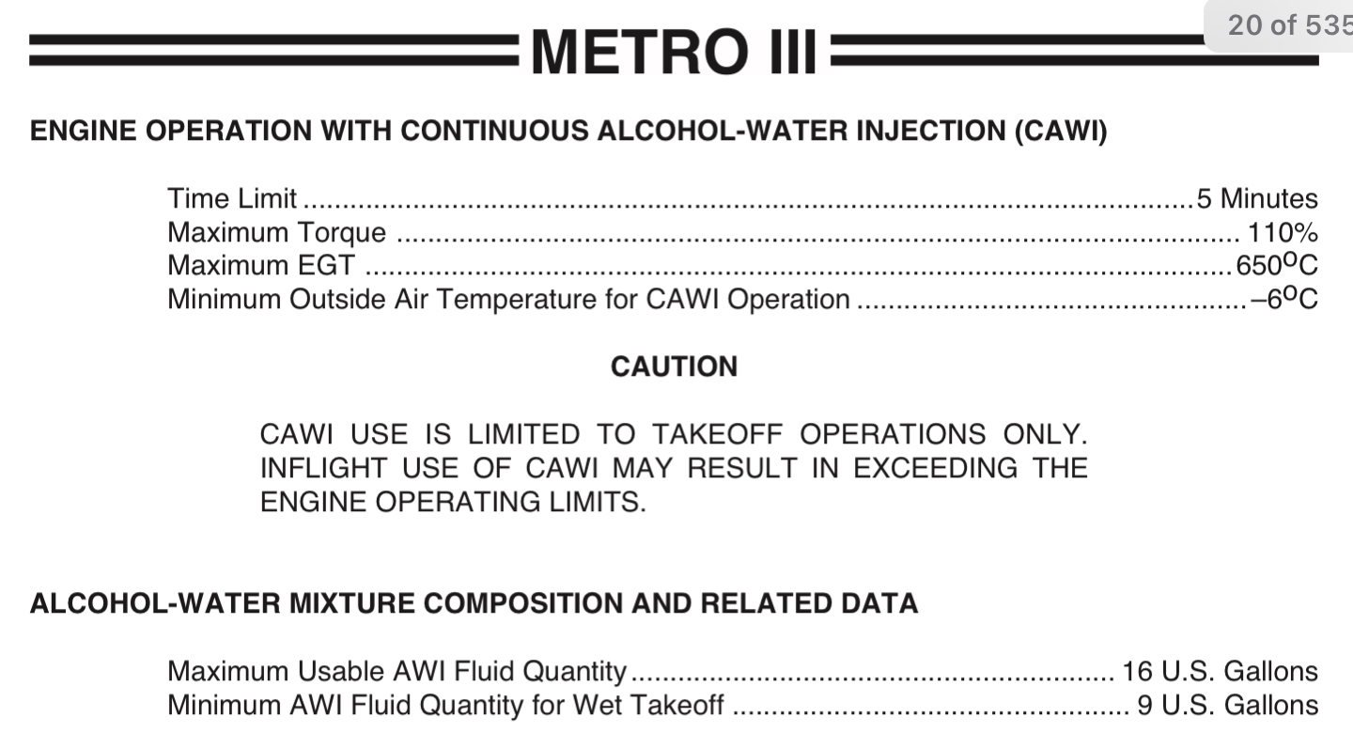
Limitations (Cawi)

Slide 15
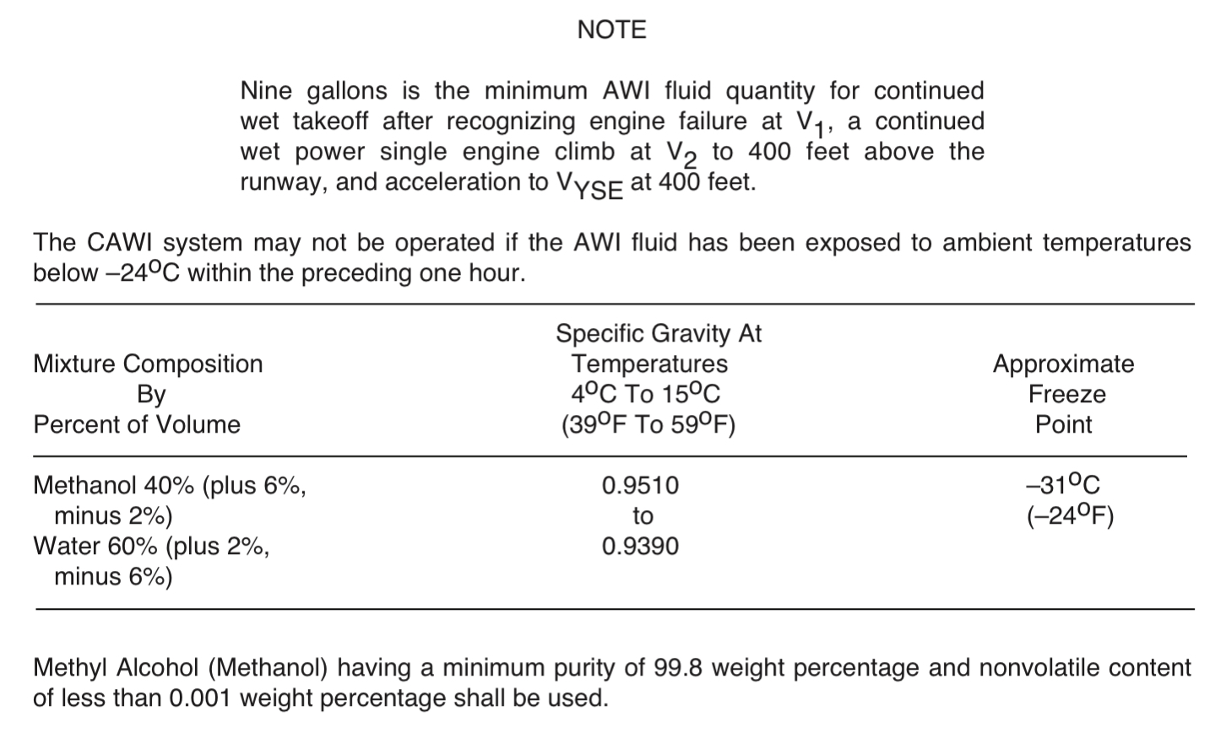
Limitations (Cawi)

Slide 16
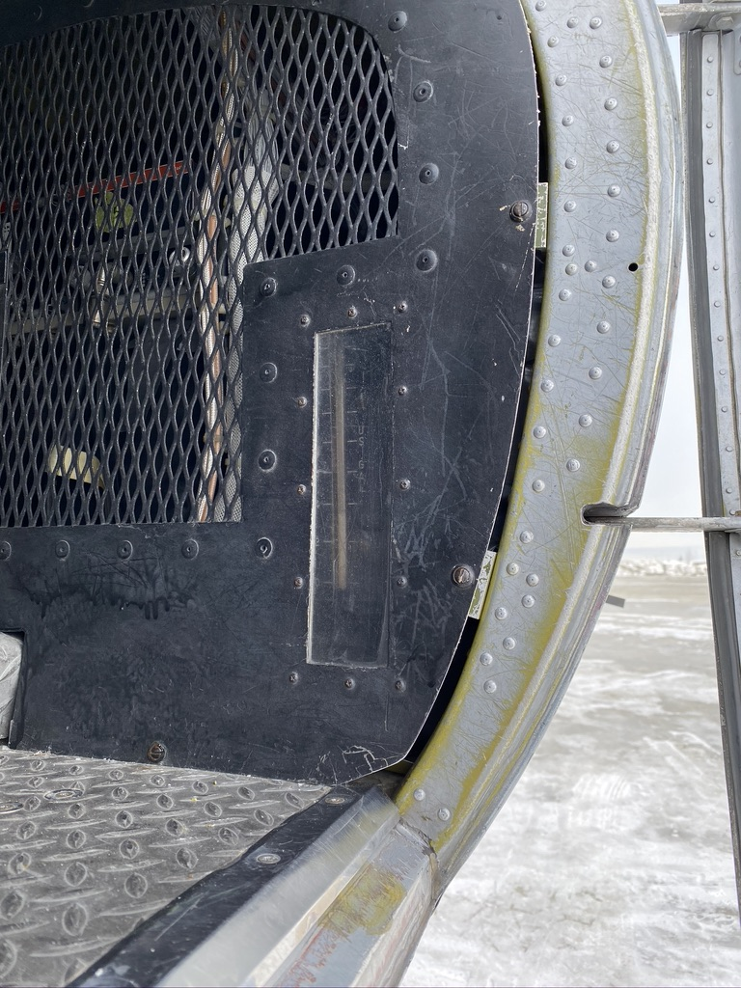
Cawi system pre-flight check

Slide 17
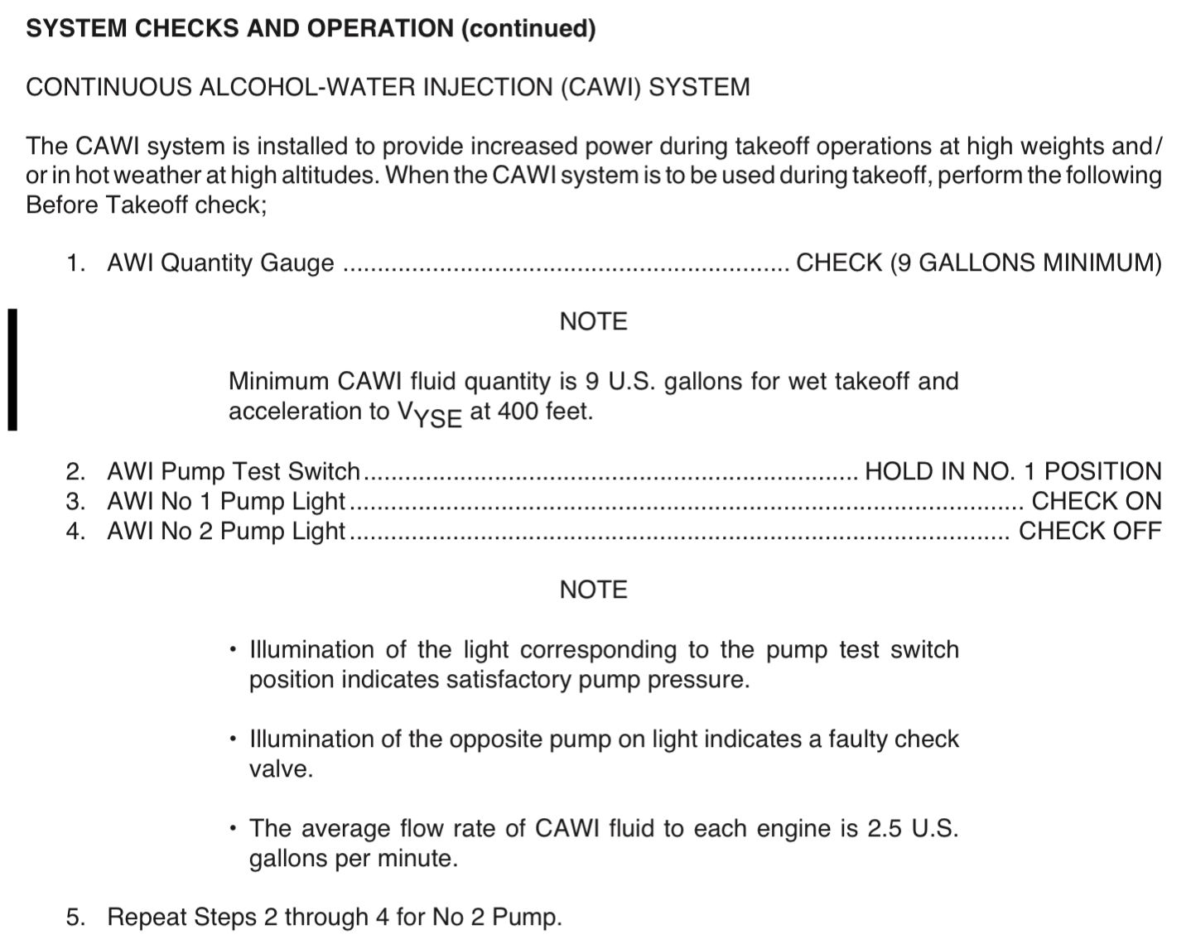
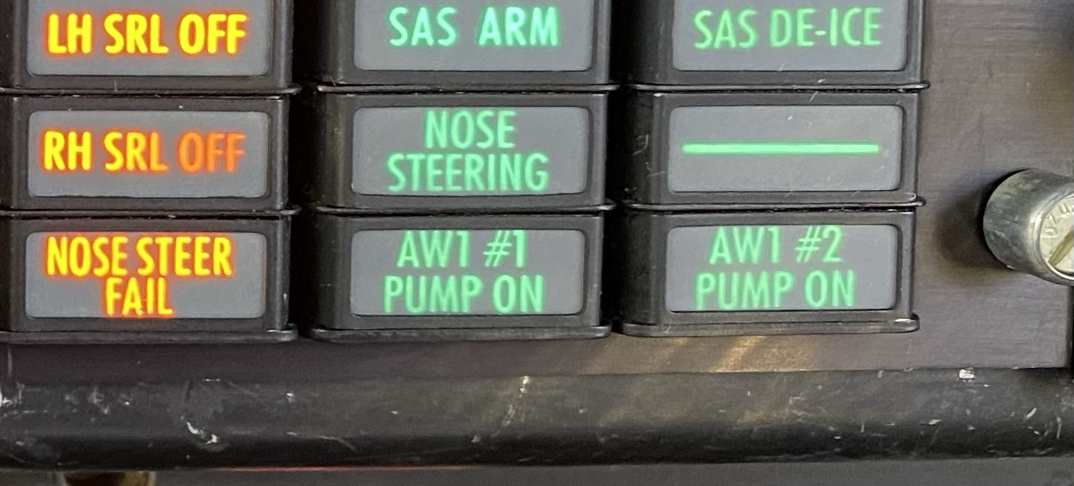
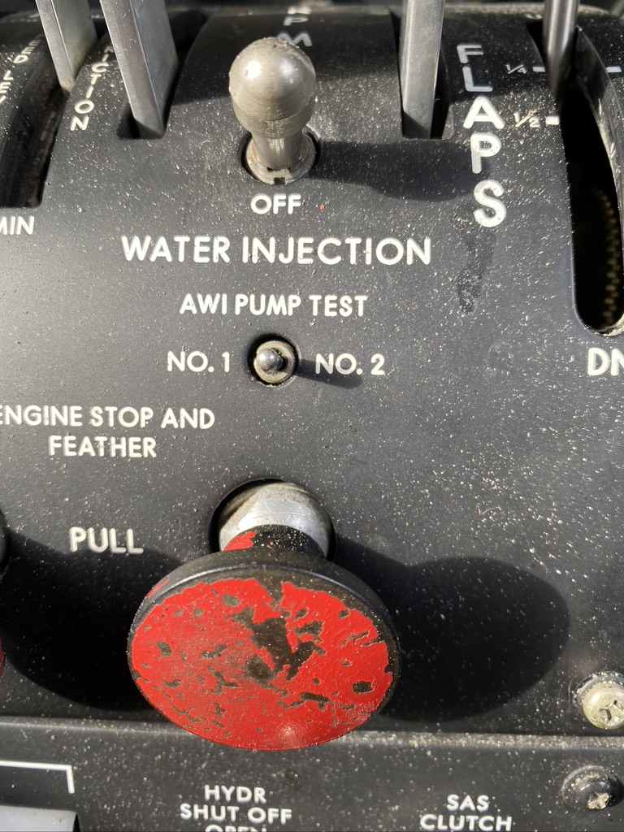
Cawi system check

Slide 18
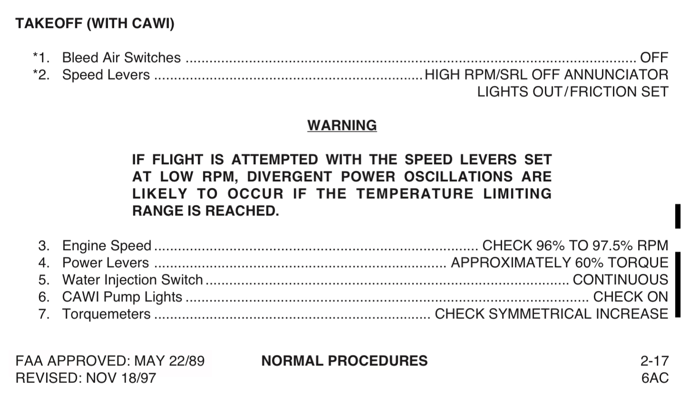
Cawi normal takeoff

Slide 19
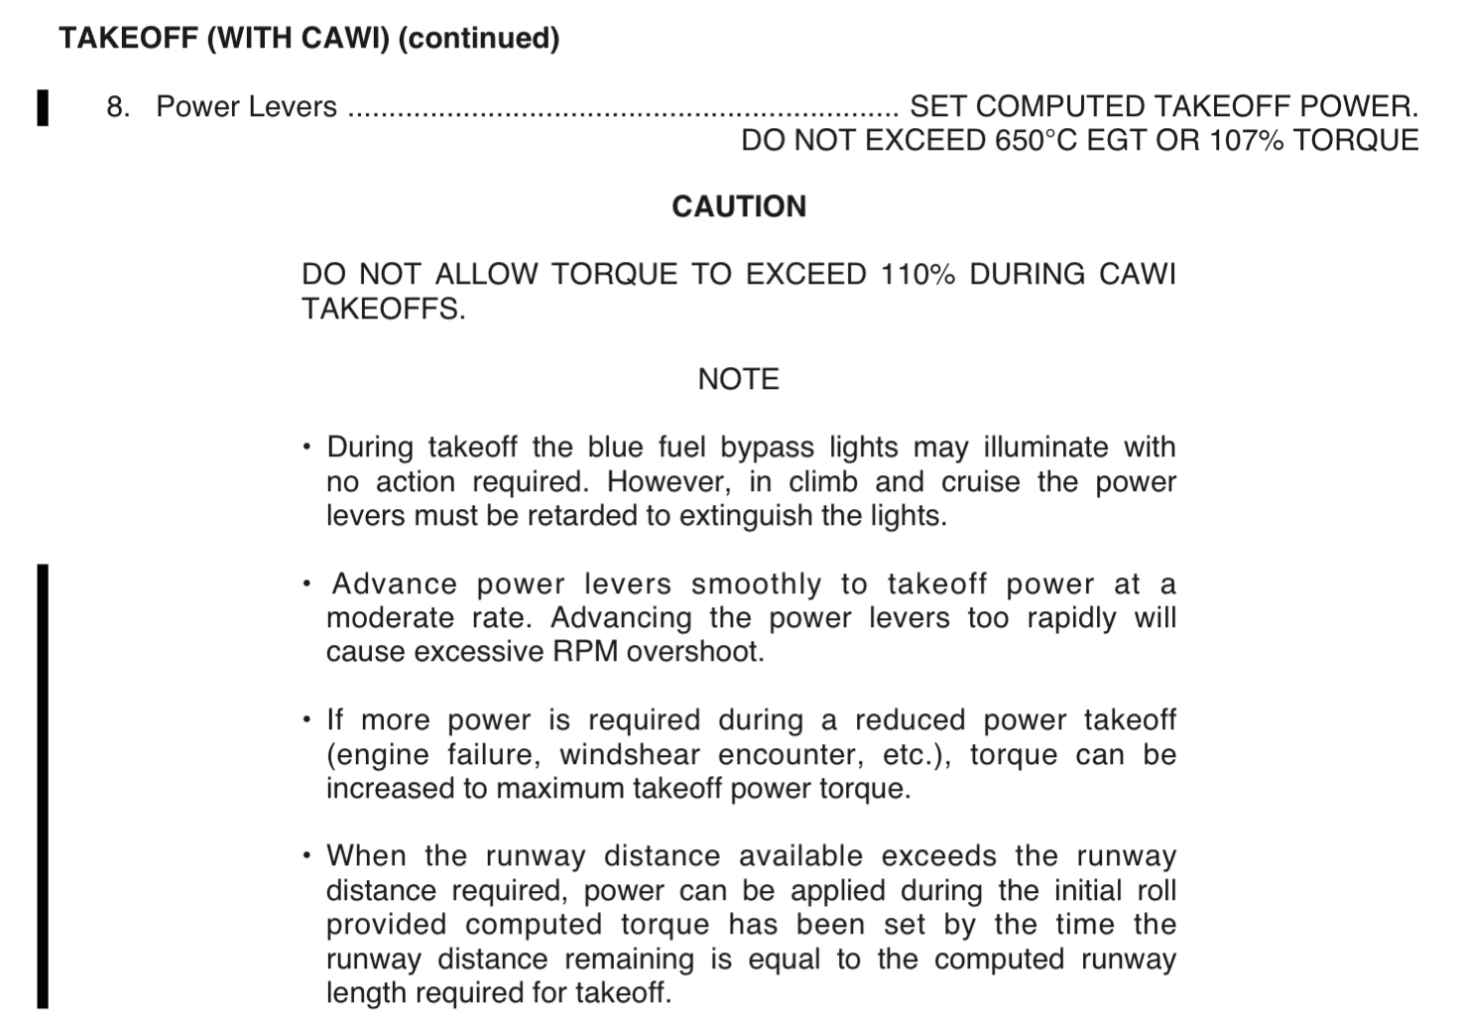
Cawi normal takeoff (cont.)

Slide 20
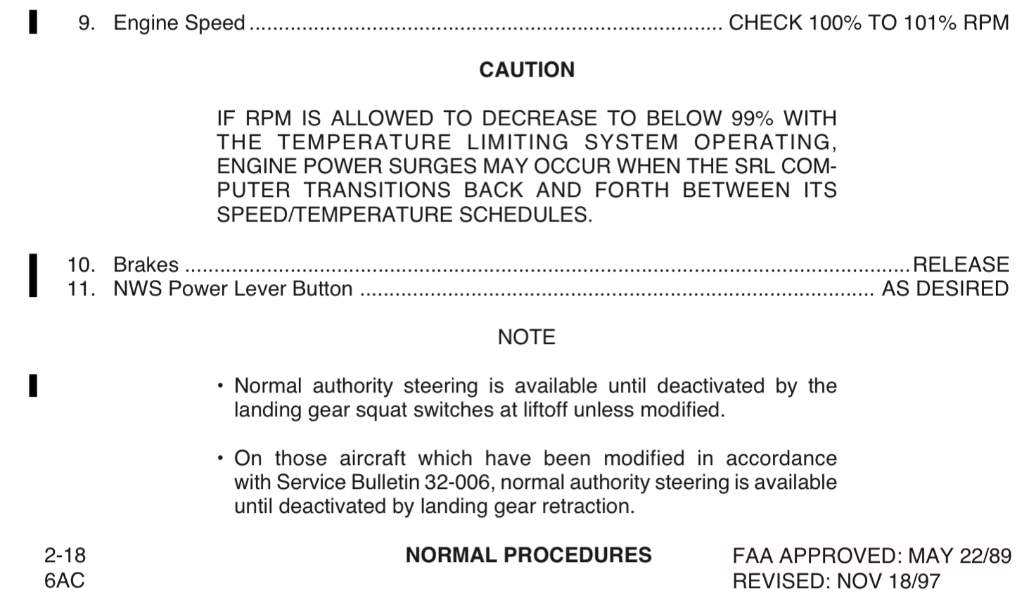
Cawi normal takeoff (cont.)

Slide 21
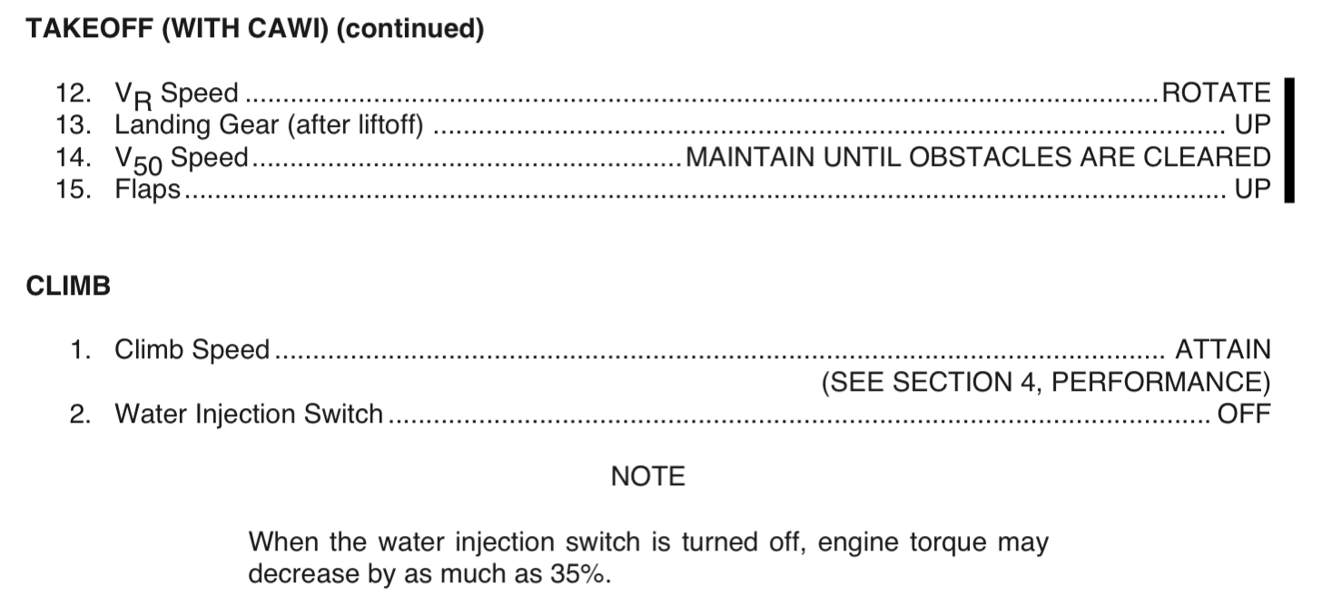
Cawi normal takeoff (cont.)

Slide 22
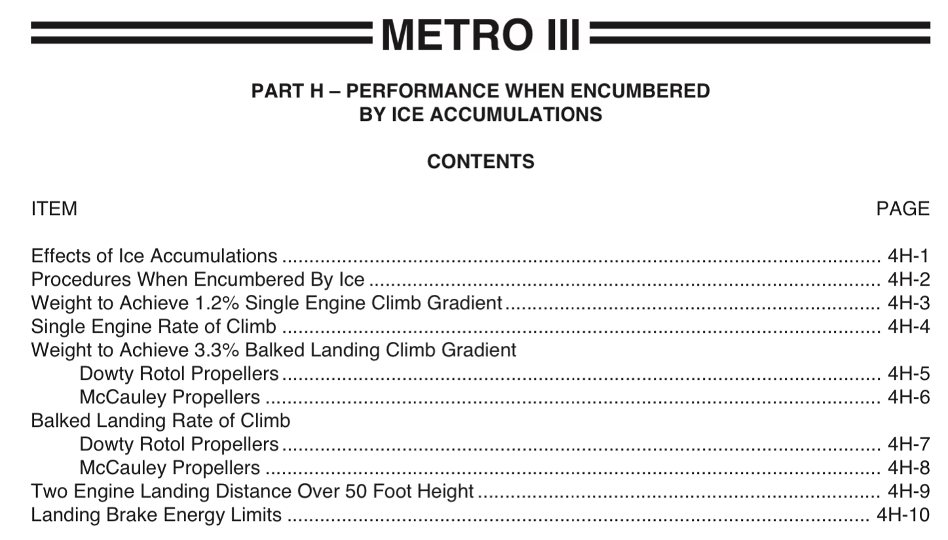
Afm performance section

Slide 23
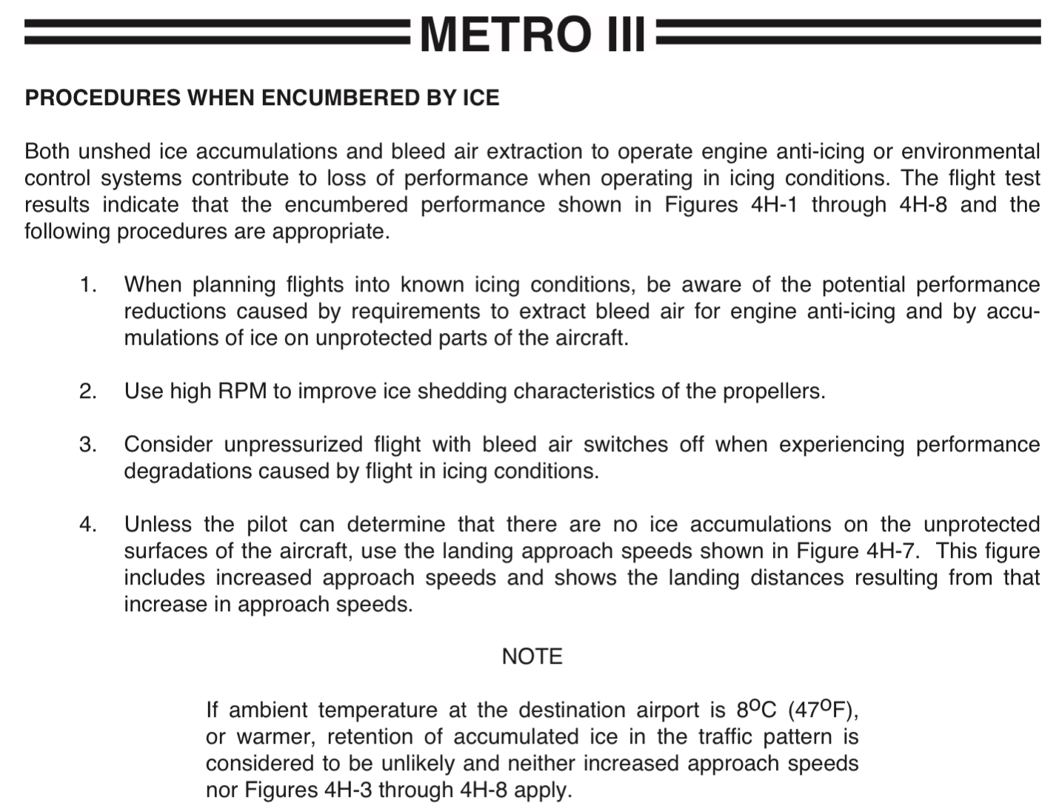
Afm performance section

Slide 24
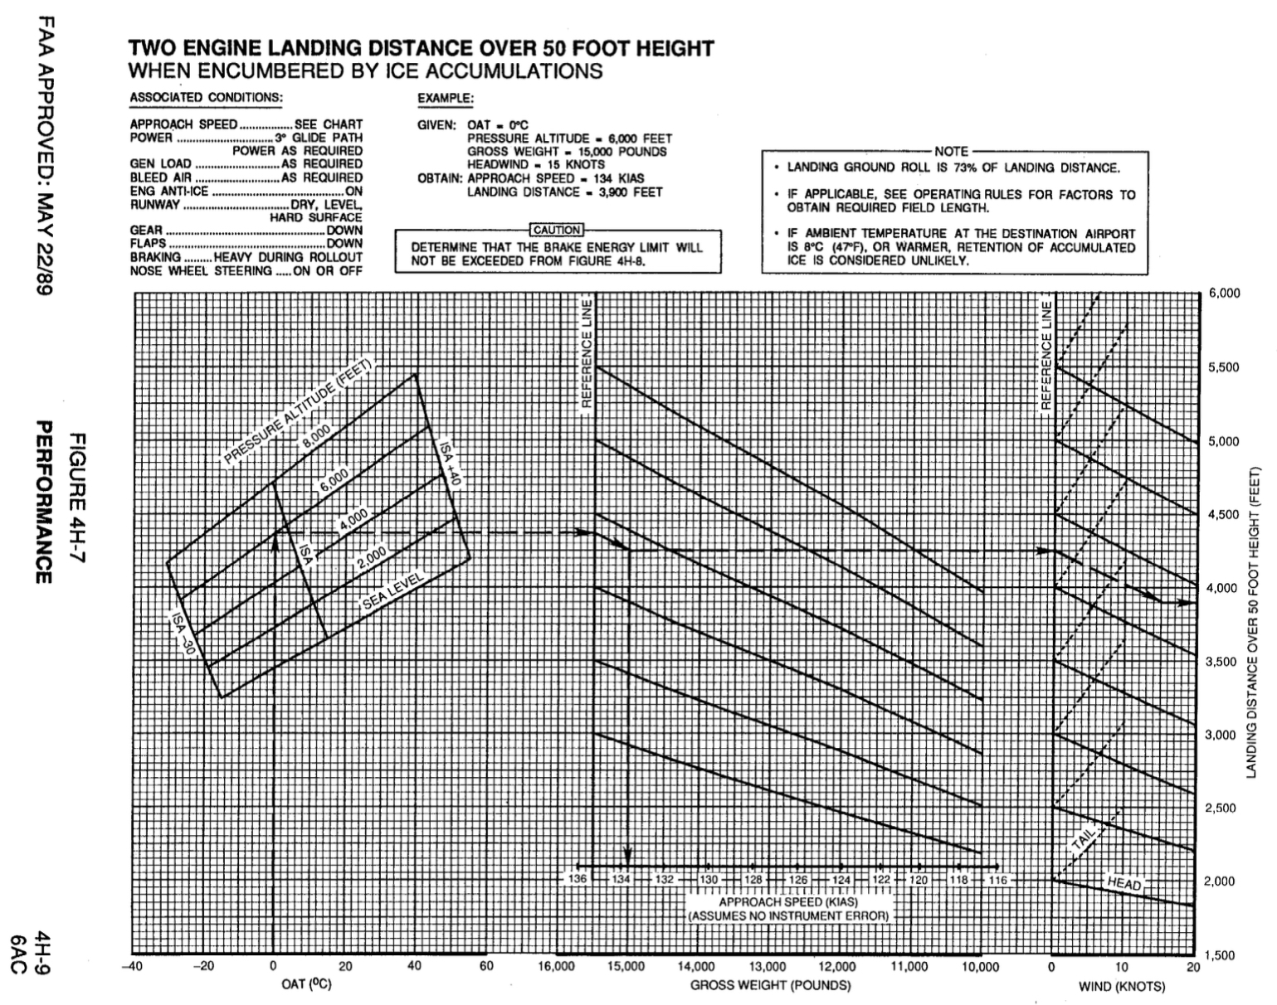
Afm performance section
Obtain Vref for a landing with ice on wings:
Conditions:
OAT -10 C
Sea Level
15,000 lbs
ANSWER: Vref = 134 KIAS

Slide 25
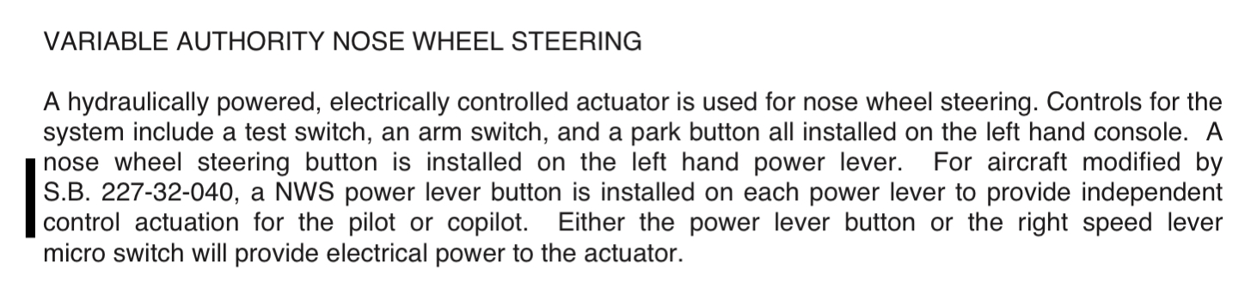
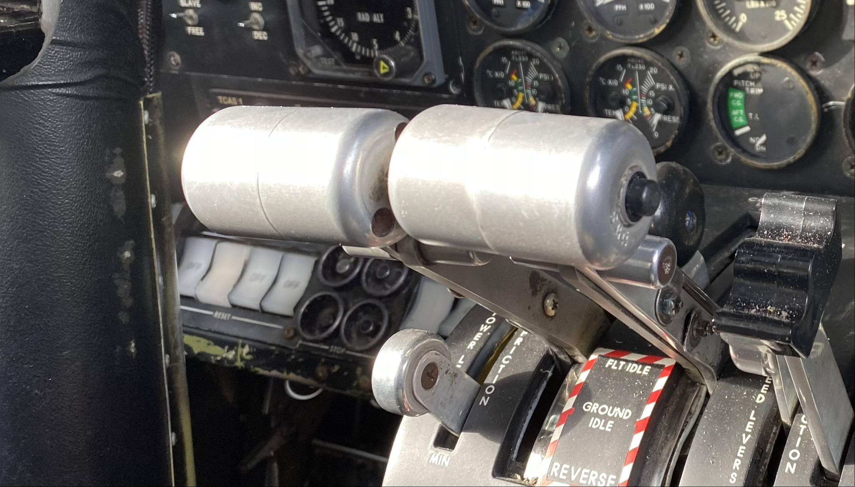
Nose wheel steering

Slide 26
Weight & balance (Sample ups anc-adq)
16,000 lbs Metro
14,500 lbs Metro
Aircraft empty weight: 8,989 lbs
Fuel: 2,100 lbs
Pilots: 360 lbs
Available payload for UPS: 3,051 lbs
Aircraft empty weight: 9,206 lbs
Fuel: 2,100 lbs
Pilots: 360 lbs
Available payload for UPS: 4,287 lbs
(Note, company policy is 3,000 lbs)

Slide 27
Weight & balance (Sample ADQ-anc, fishload)
14,500 lbs Metro
16,000 lbs Metro
Aircraft empty weight: 8,989 lbs
Fuel: 1,300 lbs
Pilots: 360 lbs
Available payload for Fish backhaul:
13,130 – 8,989 – 360 = 3,781 lbs
Aircraft empty weight: 9,206 lbs
Fuel: 1,300 lbs
Pilots: 360 lbs
Available payload for Fish backhaul:
13,900 – 9,206 – 360 = 4,334 lbs

Slide 28
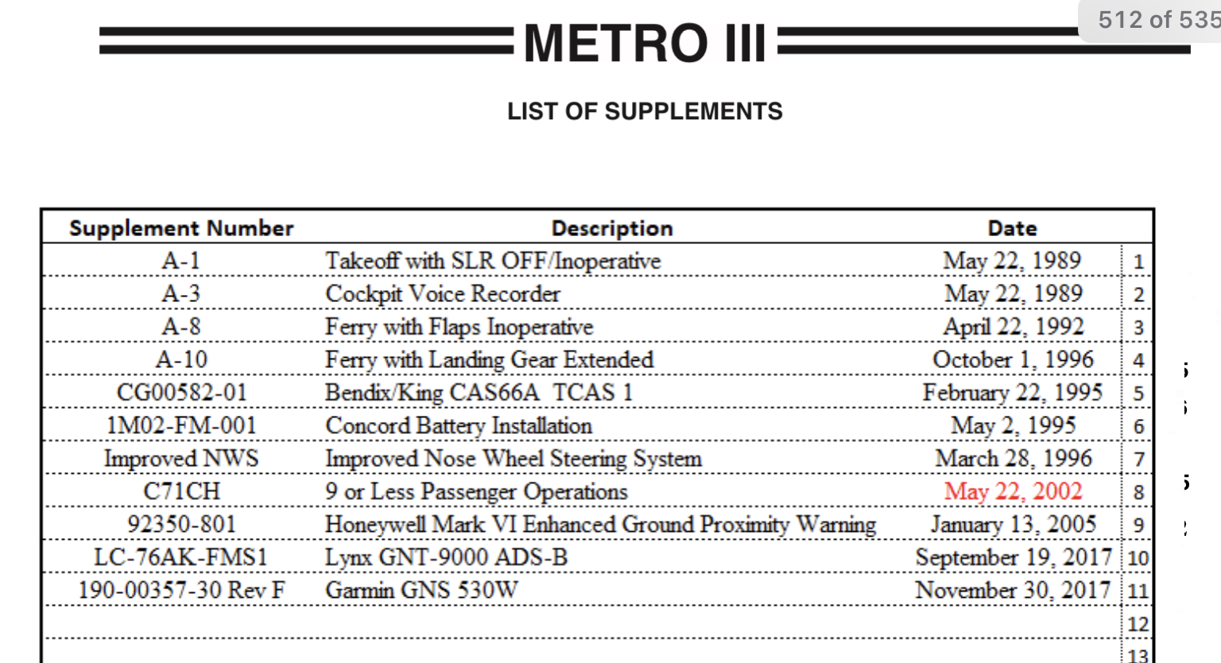
List of supplements

Slide 29
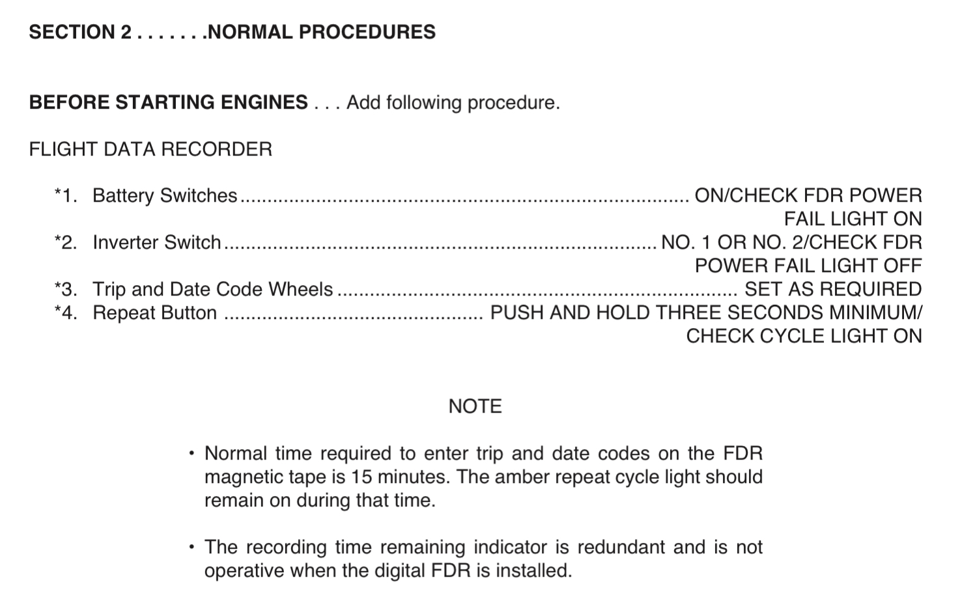
Fdr pre-flight check

